Slide 1

Chicago Traffic Crashes
Team 12 – Jiayi, Jiechen, Dhaval, Divya

Slide 2

Motivation
Alleviating Human Impact
Improving Public Safety
Mitigating Financial Toll
Proactive Protection
Lifesaving Interventions
Notes:
Human Impact: Excessive accidents have real consequences for people's lives - trauma, losses, and suffering we aim to alleviate.
Public Safety: These models enable agencies to directly protect public wellbeing by informing preventative actions.
Financial Toll: Mitigating crashes provides economic relief by reducing the over $100 million annual price tag of accidents.
Proactive Protection: We can now pivot from reactive to predictive - getting ahead of risks instead of responding after the fact.
Lifesaving Insights: Our models translate to interventions that save lives by flagging conditions requiring heightened vigilance.

Slide 3
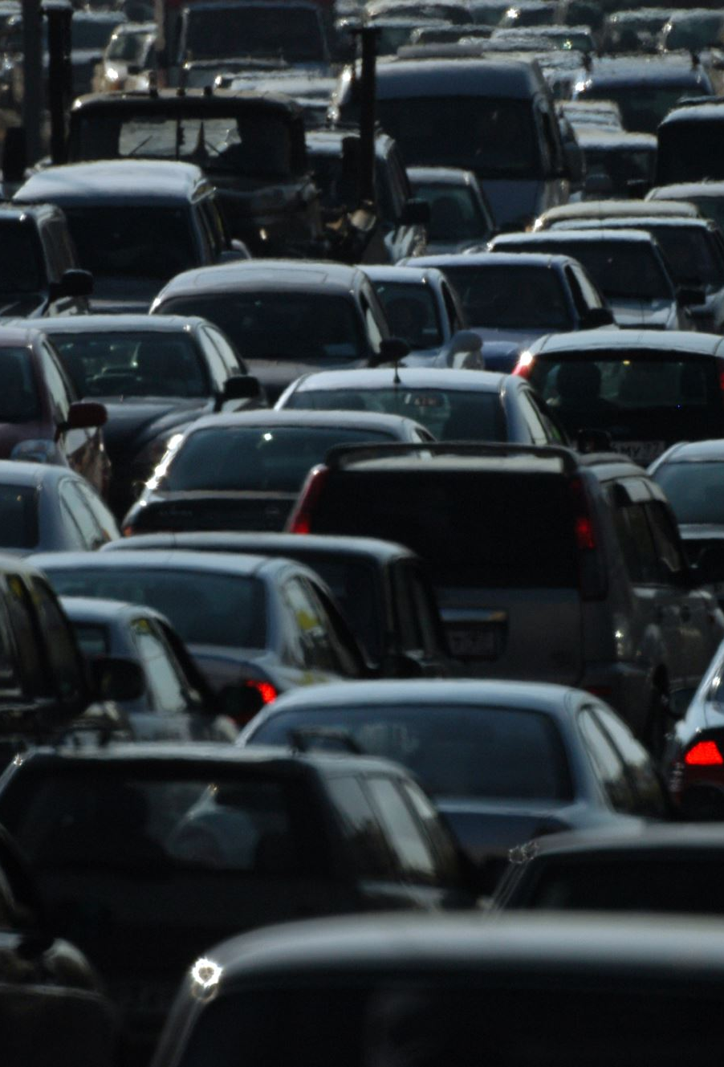
Gathering Data
Source: Traffic Crashes data from the City of Chicago Data Portal
Contents: Detailed incident-level records on all reported motor vehicle crashes in the City of Chicago from 2015 to present
Volume: Over 700,000 crash observations, spanning 49 attributes
Key Strengths:
Large in-scope duration - 7 years of data
Granular details and insights per incident
Tailored to city infrastructure and traffic conditions

Slide 4







Data Overview
Location: Latitude and Longitude, Distance to Downtown
Date and Time: Hour of day/ day of week/day of month
Injuries: Number and type of injuries that occurred
Damages: Estimated damage cost of crash
Crash Type: Type of crash – no right of way, intersection related etc.
Weather Conditions: Weather, Lighting, traffic, traffic control devices, roads etc.

Slide 5



Research Questions
Can we identify high-impact accidents based on crash characteristics?
How long does it take for the police to be notified upon accident?
Notes:
Given that there is a crash, based on the location, time, crash type, and surrounding road and traffic conditions, how much damage is to be expected (<=1.5K$ or >1.5K$
How long it takes in minutes for police to be notified upon accident, given the nature of the accident?

Slide 6
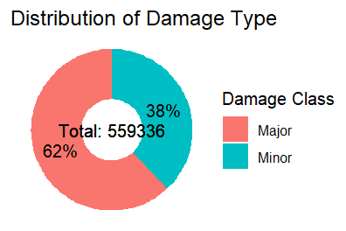
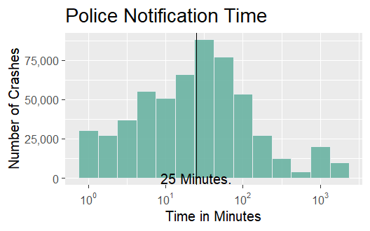
Exploratory Data analysis

Slide 7
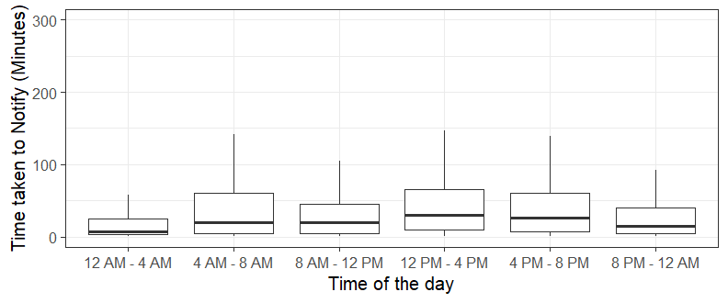
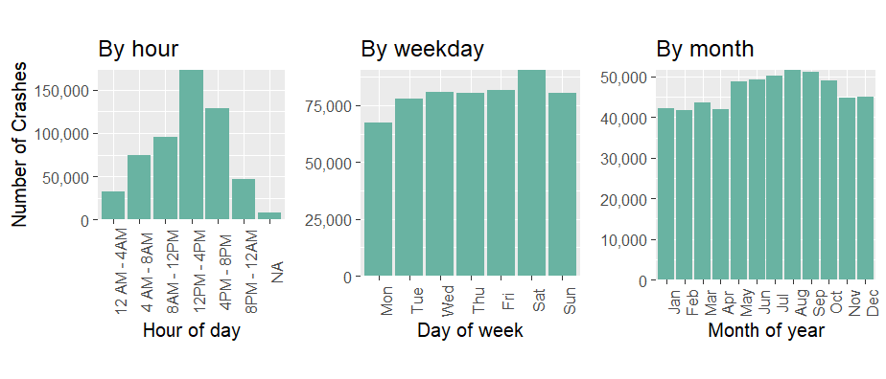
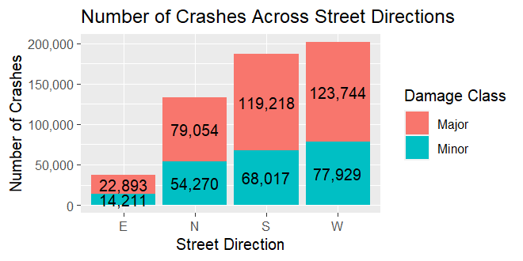
Exploratory Data analysis
Scatter Plot for Time taken to notify police (in Minutes)
Distribution of Crashes by Hour of day, Day of week, and Month of year

Slide 8



Methods used
Question 1: Cost Impact Classification
Damage Size: < $1.5K or > $1.5K
Method: Logistic Regression
Question 2: Time to Notify Police
Time Taken: Continuous (Minutes)
Method: Linear Regression

Slide 9


Model 1: Cost Impact Classification
Question: Can we identify high-impact accidents based on crash characteristics?
Method: Cost Impact Classification
Damage Size: < $1.5K or > $1.5K
Method: Logistic Regression
Results:
Even Distribution in Prediction Probability
Stability Post-Outlier Exclusion
Mixed Levels of Multicollinearity
Moderate Accuracy in Severe Accident Prediction (True Positives)

Slide 10

Model 2: Time to Notify Police
Research Question: How long does it take for the police to be notified upon accident?
Question 2: Time to Notify Police
Time Taken: Continuous (Minutes)
Method: Linear Regression
Results:

Slide 11



Limitations and future work
Limitations
Challenge: Removed missing values because no information on missing
Risk: Added external data that may misrepresent the dataset
Potential Improvement
Address Missing Values: Identify reasons for missing data and perform imputation
Enhance Dataset: Include additional variables for a comprehensive view
Driver-related Variables: Age, gender, years of driving, drinking alcohol
Behavioral Variables: Speeding, distracted driving (phone use, etc.), seatbelt usage
Introduce new models: Decision Trees, Random Forest

Slide 12
Thank You
Team 12 – Jiayi, Jiechen, Dhaval, Divya

Slide 13
Exploratory Data analysis
Scatter Plot for Time taken to notify police (in Minutes)
Distribution of Crashes by Hour of day, Day of week, and Month of year

Slide 14
Results
Logistic Model
Even Distribution in Prediction Probability
Stability Post-Outlier Exclusion
Mixed Levels of Multicollinearity
Moderate Accuracy in Severe Accident Prediction (True Positives)

